Slide 1
Planning for Post-College Life
Team 2: Easing Life Transitions

Slide 2
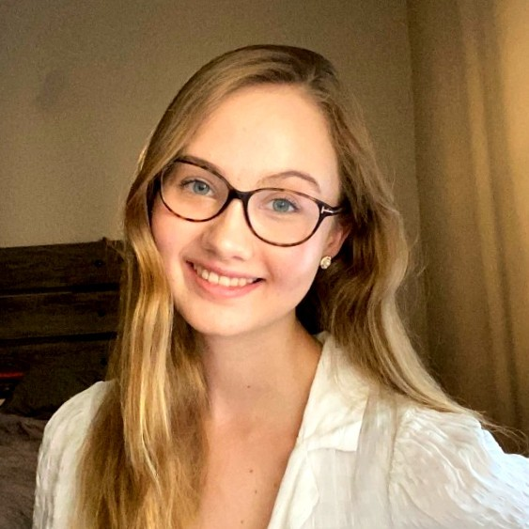
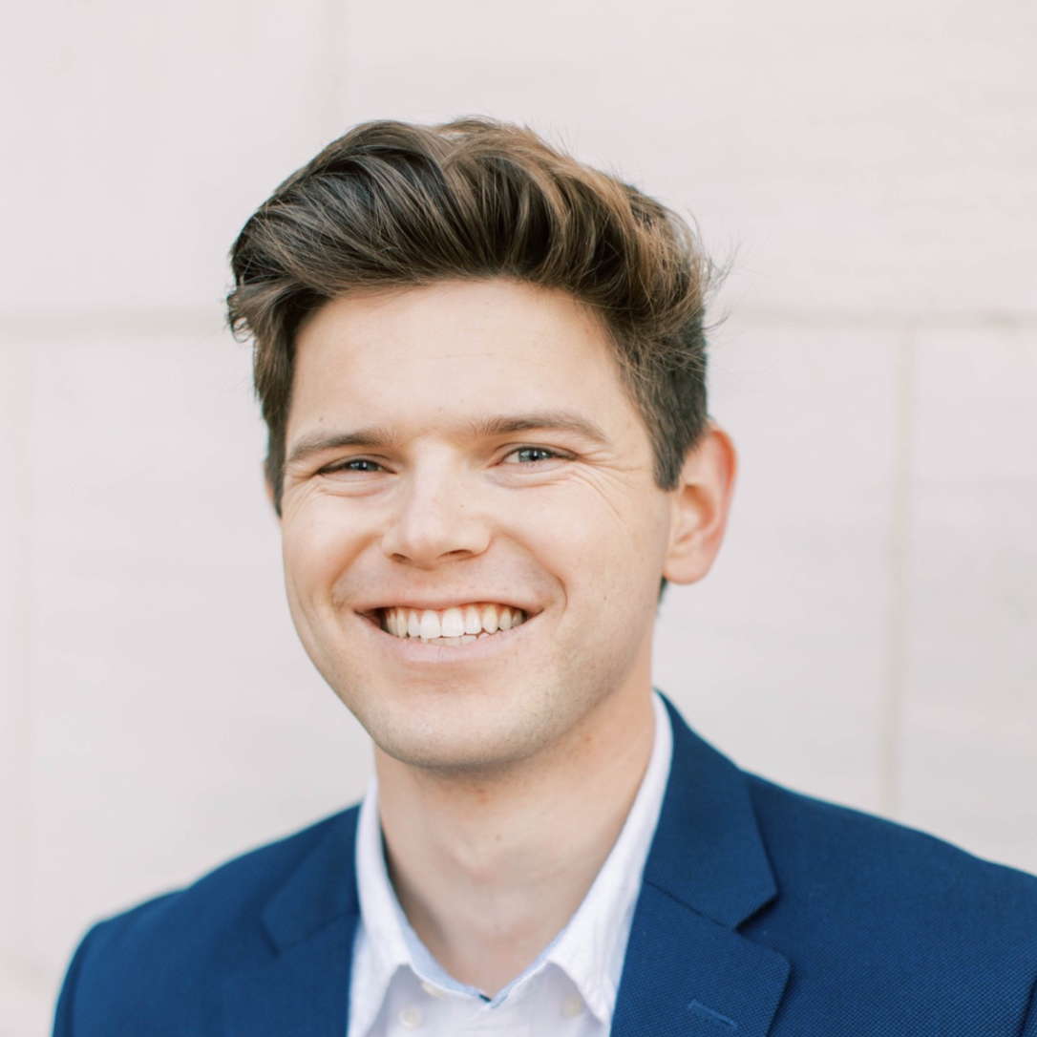
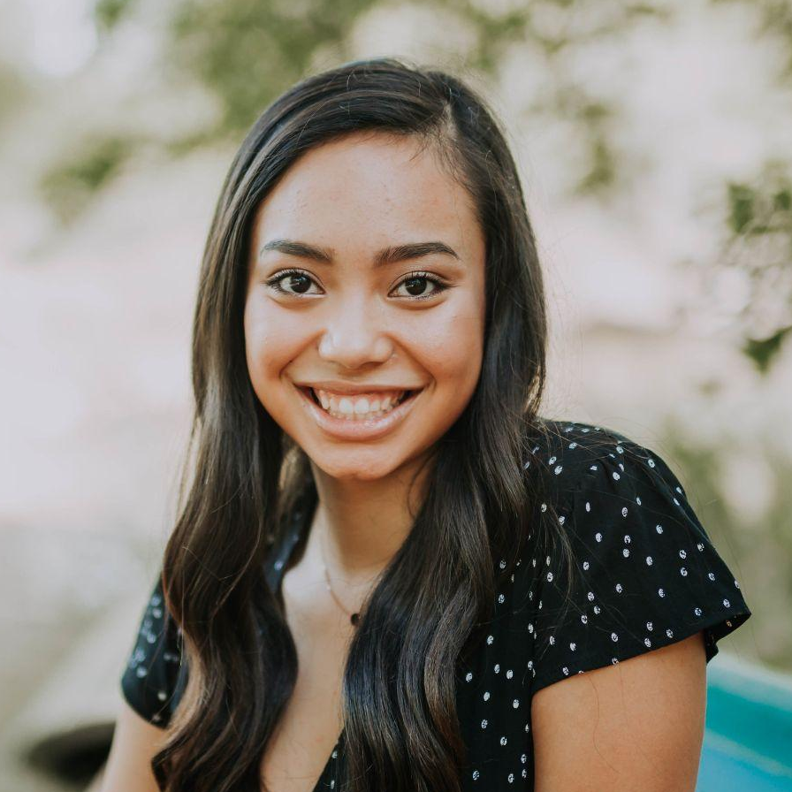
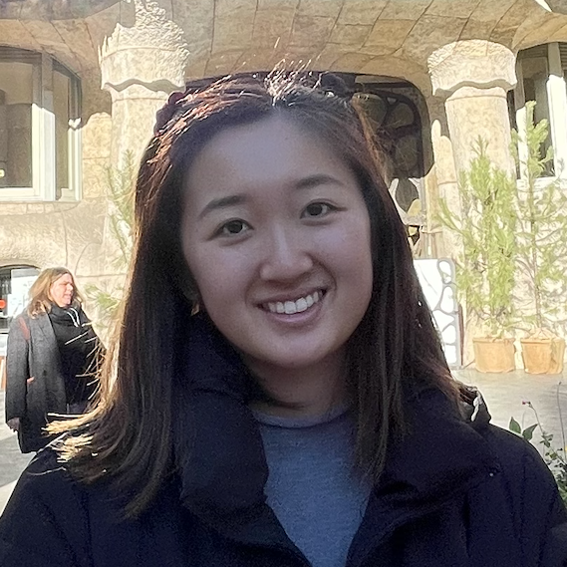
Our Team
Amelia
Chris
Jasmine
Tiff
Senior
Math & CS
Junior
SymSys
Senior
MS&E & CS
Senior
SymSys & English

Slide 3
1
Initial PoV
Rachel, from Week 1 interviews

Slide 4

Rachel
Recent NYU Grad
Started a job in marketing in a borough in NYC away from her college friends
Living alone for the first time

Slide 5
Initial PoV
We met Rachel, a recent NYU graduate who just started living alone in a new NYC neighborhood away from her college friends, and working FT
We were surprised to notice that she felt too old for her same-aged friends still in college but too young for her work friends
We wonder if this means she is unable to relate to people who are in different life stages than her, even those whom she is close to in age
It would be game-changing to help her find common ground with the people she associates with despite being in different life stages

Slide 6
Needfinding
2
Round 2

Slide 7
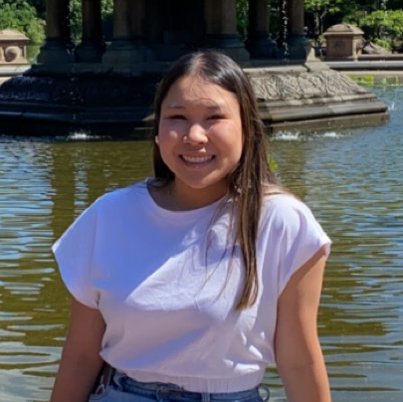
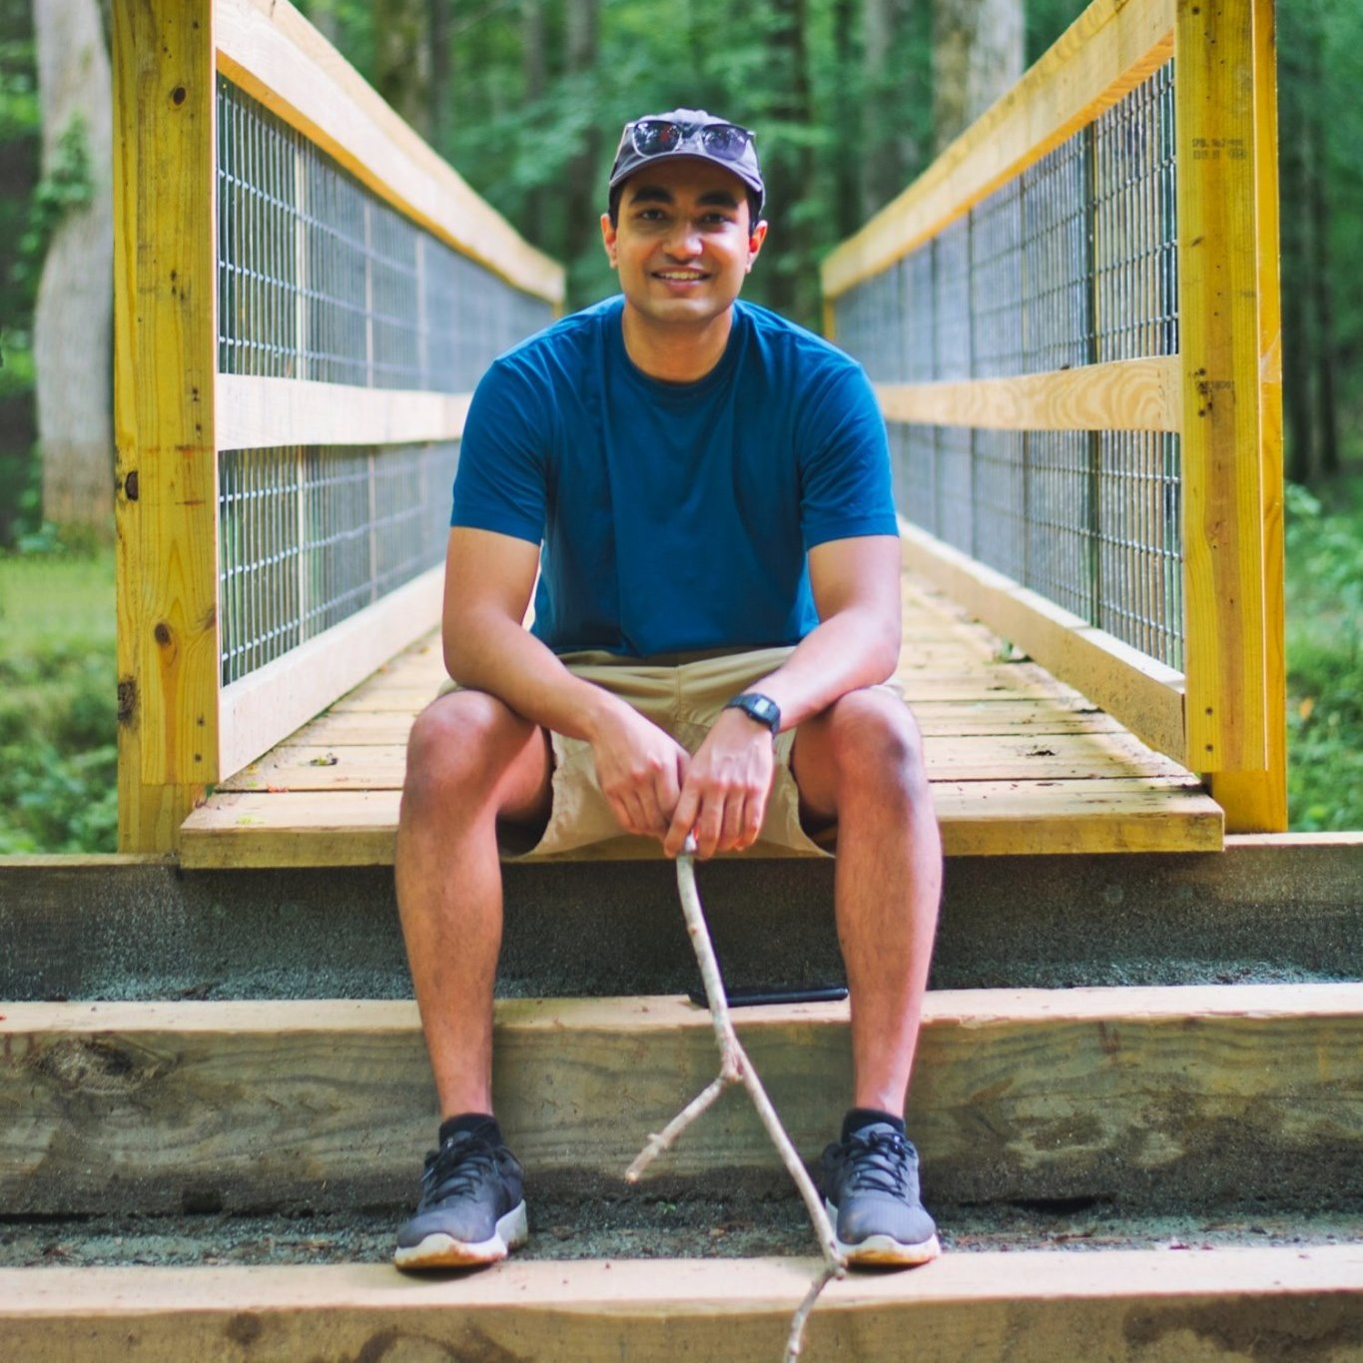
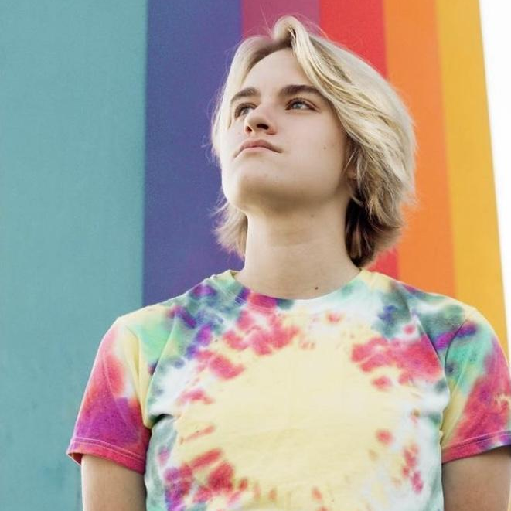
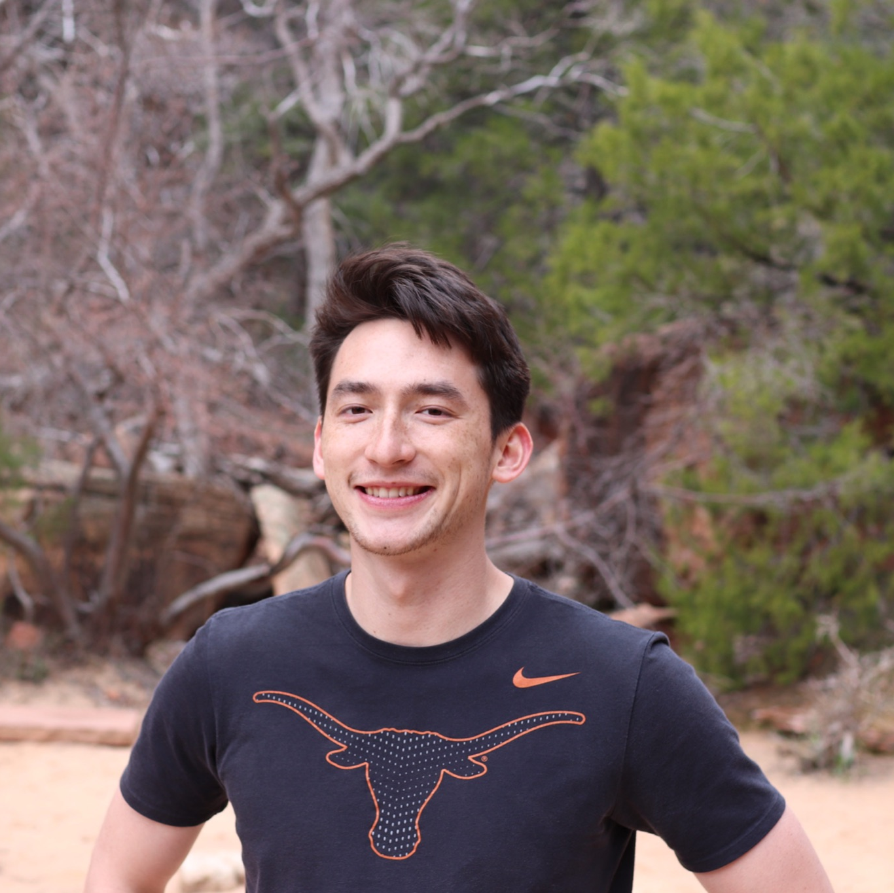
4 Additional Needfinding Interviews
Madelynn
Mihir
Mindy
Quinn
A&M Senior
Interning at company she’ll return to FT after graduating
International student, Senior
Moving to San Diego to start a new job after graduating
UCSB Senior
Considering various grad programs and jobs
UT Austin graduate
Switched jobs and moved back home to Arizona

Slide 8
Insights - Madelynn
Leans on company for community–they provide her with mentors and pre-defined groups of people with shared interests she can join

Slide 9
Insights - Mihir
Looking forward to a new “socially stimulating” environment in San Diego
Has a small pre-established community of family and friends in San Diego that eases overwhelming nature of moving to a new place

Slide 10
Insights - Mindy
Not knowing what people’s lives after graduation are like makes it hard to narrow down post-graduate options
Goes to coffee shops when in a new place and makes a judgement on the “vibe” of the community based on the people there

Slide 11
Insights - Quinn
There is tension between securing a job quickly and spending time to consider more options and find the “right job”
Found community in a new place through online groups and workplace social events

Slide 12
3
New PoVs

Slide 13
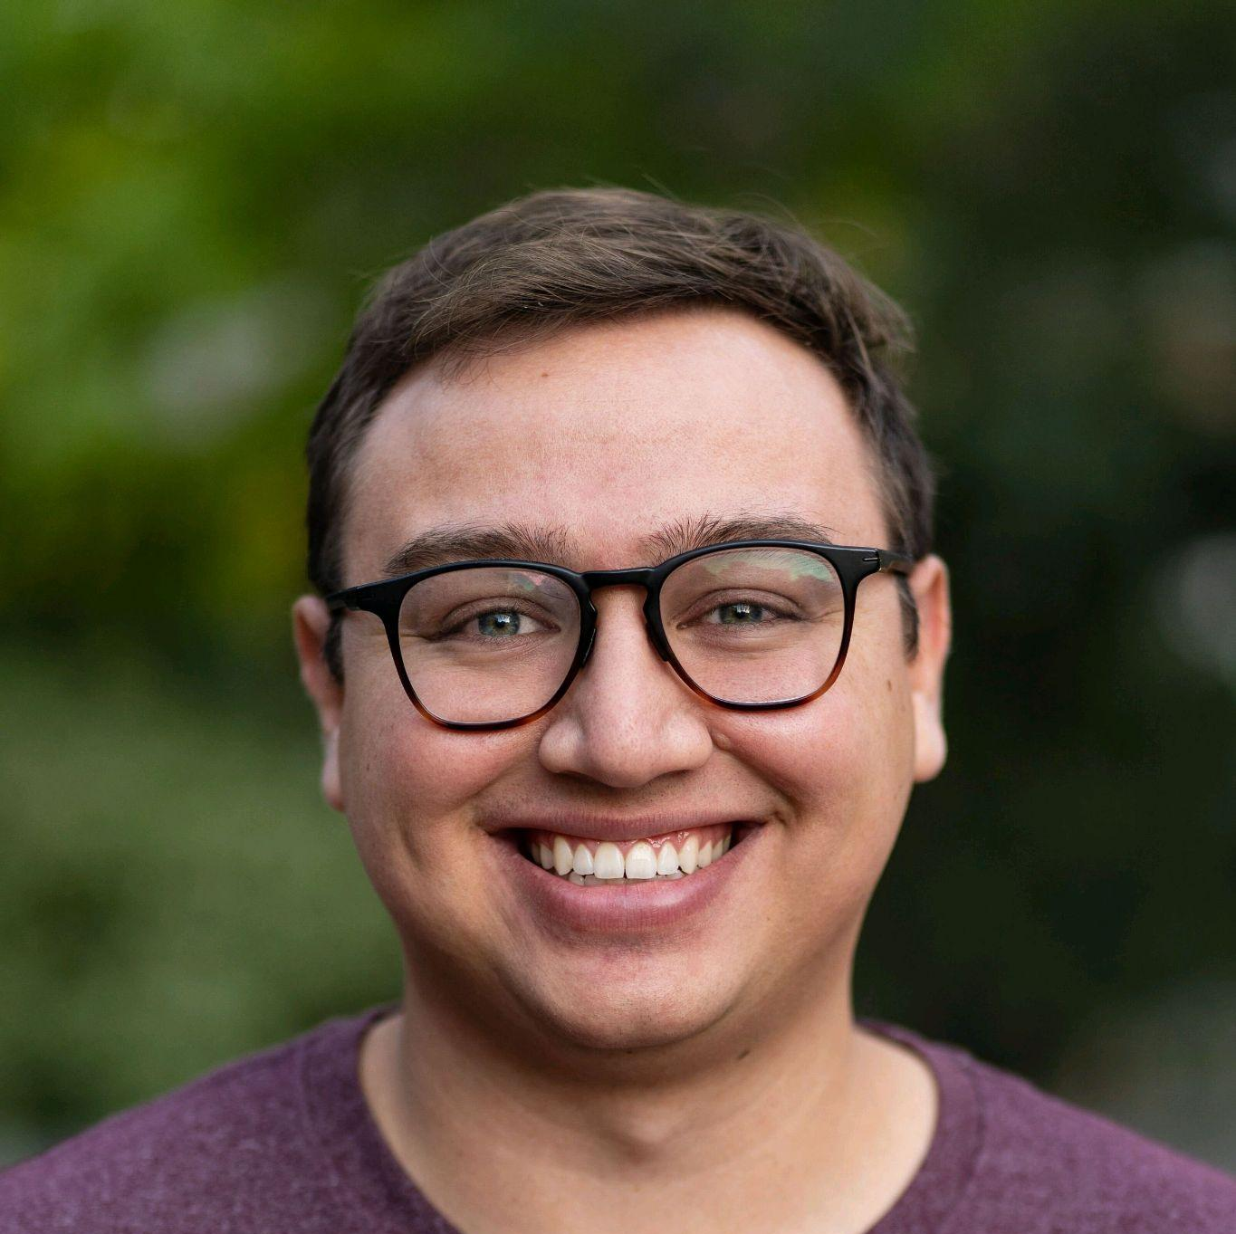
PoV - Enrique
We met Enrique, a recent ASU graduate in accounting and new house owner; now working as a financial controller at a mid-sized startup.
We were surprised to notice that he felt dissatisfied with resources to plan out his less-conventional career path and post-college plans.
We wonder if this means that the ‘set menus’ (i.e., post-college pathways presented by college counselors and advisors) did not reflect his priorities as a homeowner, strong saver and investor.
It would be game-changing to expose college students to more unconventional college and post-graduate paths.
Notes:
Key: Individually like→Collectively love→Top Repeats
HMW…
Change the status quo on what is considered conventional post college logistics wise
Change the status quo on what is considered a conventional career path post college
Get college advisors to help students visualize different post grad paths
Give college students the skills and tools to map out potential decisions and priorities of their post grad paths **
How might we make 'set menus' more customizable and personalizable *
Find post-grad opportunities that most fit students’ interests and priorities
Change student perceptions around conventional job paths and encourage them to expand their options
Help people identify unexpected options that they might not be considering for their career **
Help college students map out the risks of different college paths
Help Enrique meet other students going down the same post-graduate paths as him *
Connect Enrique to other people further along in unconventional career paths that he’s interested in
Help students feel confident in going down an unconventional / less-known post-grad path
Reduce the pressure from external sources on students to take well defined paths *
Help students identify more unusual opportunities earlier in college so they can plan more **
Help Enrique utilize conventional resources to learn about his unconventional path
Help students compare truly different post-grad options that incorporate a wide variety of perspectives and experiences
Make it easier to design custom paths rather than relying on "set menu" paths
Make financial literacy and independence a priority in "conventional" college planning *
Teach students about post-grad priorities that might be unexpected during college

Slide 14
PoV - Mindy
We met Mindy, a UCSB Senior simultaneously exploring job and grad school opportunities.
We were surprised to notice that Mindy cares more about people's day-to-day life/social experiences rather than their overall views of their job or grad school program.
We wonder if this means that the lack of ability to actually visualize herself in any of the post-grad paths she’s considering makes her indecisive about her next steps.
It would be game-changing to give Mindy an honest look into the day-to-day lives, social interactions, and experiences of people pursuing the paths she’s considering.
Notes:
Key: Individually like→Collectively love→Top Repeats
HMW…
Compile more honest reviews and experiences of diverse individuals across jobs and grad school programs
Connect Mindy with individuals who are in the same positions / programs she’s interested in *
Help Mindy visualize the location she could be working in
Increase the flexibility of Mindy's potential day-to-day experiences in new jobs
Help Mindy understand what she wants her life to be like post-college *
Give students an honest, approachable look into the daily lives of people who have the jobs/post-grad paths that they are interested in *
Give an avenue for people to share the “day in life” experiences they have in jobs with others
Help students understand the many aspects of their potential post-grad communities beyond testimonials or reviews
Make it the norm for descriptions of jobs / grad school programs to include “day in the life” details
Help Mindy feel more confident about finding meaning and joy in her day-to-day life outside of job/career elements *
Give Mindy the experience of walking into a local coffee shop or hangout area of a community or area that she’s interested in *
Help Mindy discover the truth in seemingly superficial testimonials online from people in jobs / programs she’s looking into
Change the way that information on post-career paths is presented to be more honest
Allow Mindy receive “day in the life” info / feedback from people in her areas of interest
Give students insight into the decisions of people who switched into or out of the jobs that the students are interested in
Help identify new resources for understanding different post-college pathways
Help Mindy find meaning in her post-grad pathway regardless of what the day-to-day life is like **
Help Mindy reflect on how important other's day-to-day experiences are in her ability to be happy/find fulfillment in a new role
Help Mindy feel that she has agency over building her life post-grad both within and beyond her career *
Find mentors for Mindy to help her cultivate her best 'adult' life *
Give postgrads the chance to reflect on their day-to-day life when they talk to mentees like Mindy

Slide 15
PoV - Mihir
We met Mihir, a Senior and international student at Virginia Tech who is moving to San Diego after graduating to become a chip engineer.
We were surprised to notice that Mihir is less worried about finding communities for niche activities like hang gliding and aviation than for finding communities to participate in more generic recreational activities (bar hopping, hiking).
We wonder if this means that he feels overwhelmed by the challenge of finding a tight community when there are a large number of people who could share his interests.
It would be game-changing to increase Mihir’s ease in finding and deepening friendships from more casual activities beyond his niche hobbies.
Notes:
Key: Individually like→Collectively love→Top Repeats
HMW…
Emulate the ease for Mihir in finding niche hobby friends in more generalized recreational settings *
Help Mihir in being intentional to reach out to new grads in San Diego
Help Mihir encourage his niche hobby friends to try out other activities like bar hopping or hiking
Help create an intentional community based on values and interests rather over recreational activities*
Help Mihir turn casual friendships into lasting friendships ***
Narrow down the amount of people within Mihir’s vicinity that are interested in the same things as him*
Break down a seemingly generic activity like going to a bar into more approachable subgroups
Help people balance their friendships from more niche activities with the friends they see for more common recreational interests
Deepen the friendships people make from more generic / conventional recreational activities
Find friends for Mihir that live near him and around his same age
Make the experience of finding friends with his same generic interests the same as his experience of finding friends with his same niche interests
Make the community of people with his same generic interests seem smaller and more easy to navigate *
Help Mihir make friends with both his same generic interests and niche interests (why do these friends need to come from different pools?)
Make it easier for Mihir to do “generic” activities with people already in his circle
Emulate the camaraderie he feels with his work colleagues in communities outside of work
Reduce any stigmas around intermixing friends from different communities (i.e. friends from work with new casual friendships and niche hobby friends)
Improve Mihir's confidence to talk to more people and follow up on casual friendships and acquaintances
Help Mihir use his neighborhood environment as a new opportunity to convene with friends and meet new people
Help Mihir feel comfortable asking his friends from niche hobbies to do mainstream activities with him
Help people trade knowledge about niche hobbies by engaging in more generic recreational activities that allow them to meet more new people *

Slide 16
Experience Prototypes
4

Slide 17
How might we give college students the skills and tools to map out potential decisions and priorities of their post-graduate paths?

Slide 18
Experience Prototype 1
Solution
Assumption
Connect with people who are a few steps ahead of you in different post-graduate pathways
Comparing and contrasting different pathways will make people less overwhelmed by their post-graduate decisions

Slide 19
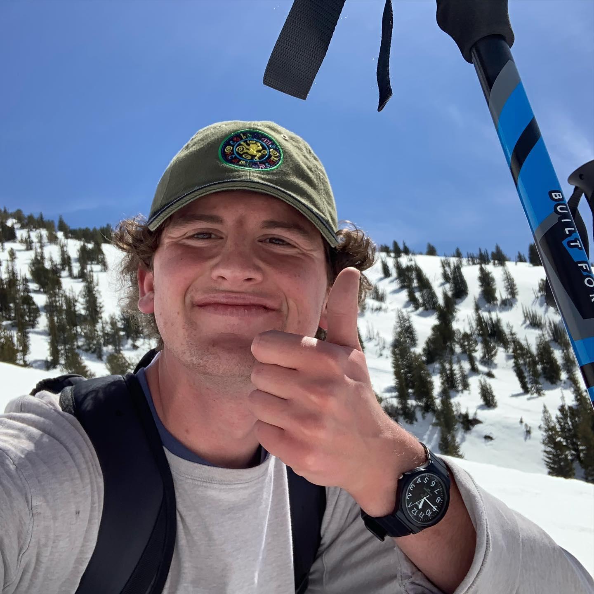
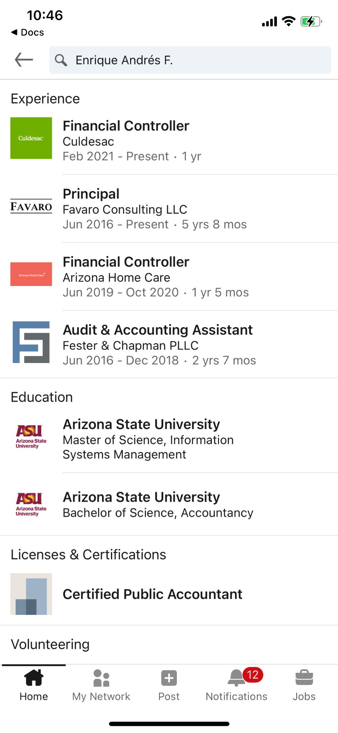
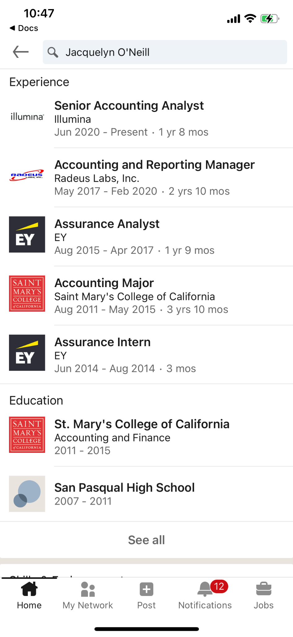
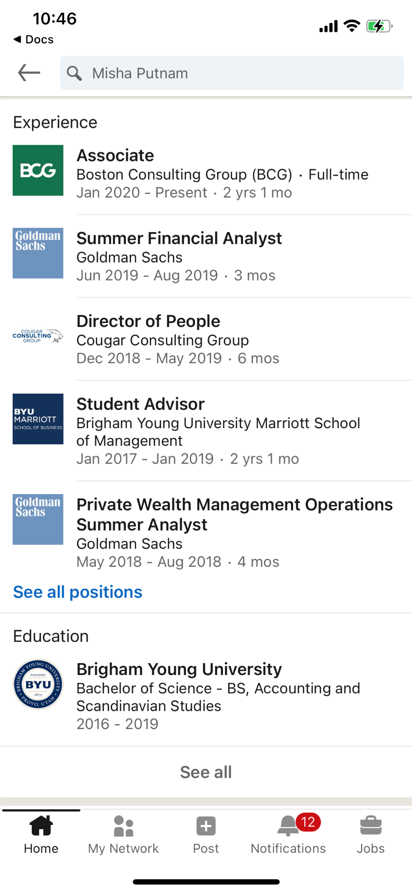
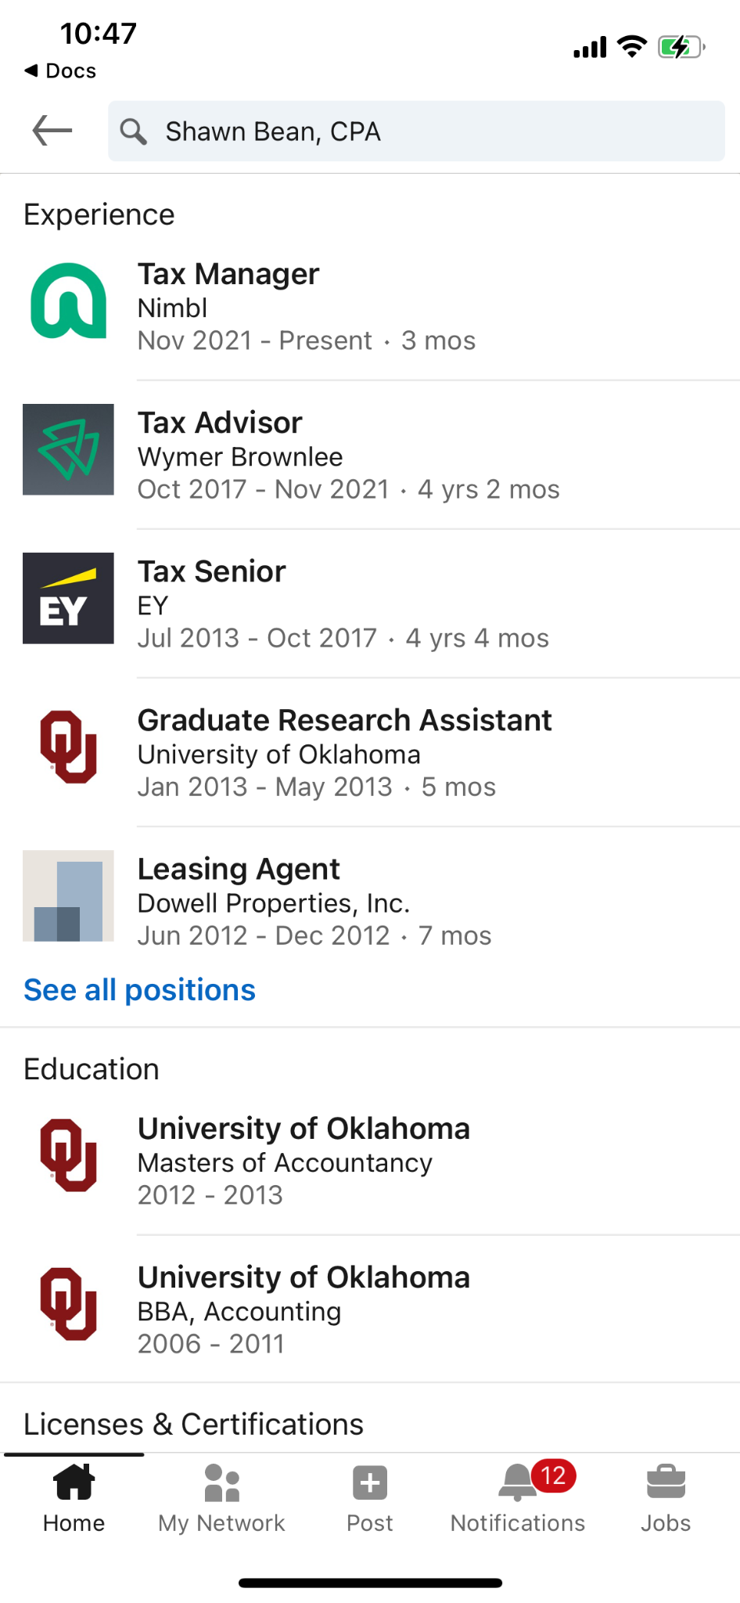
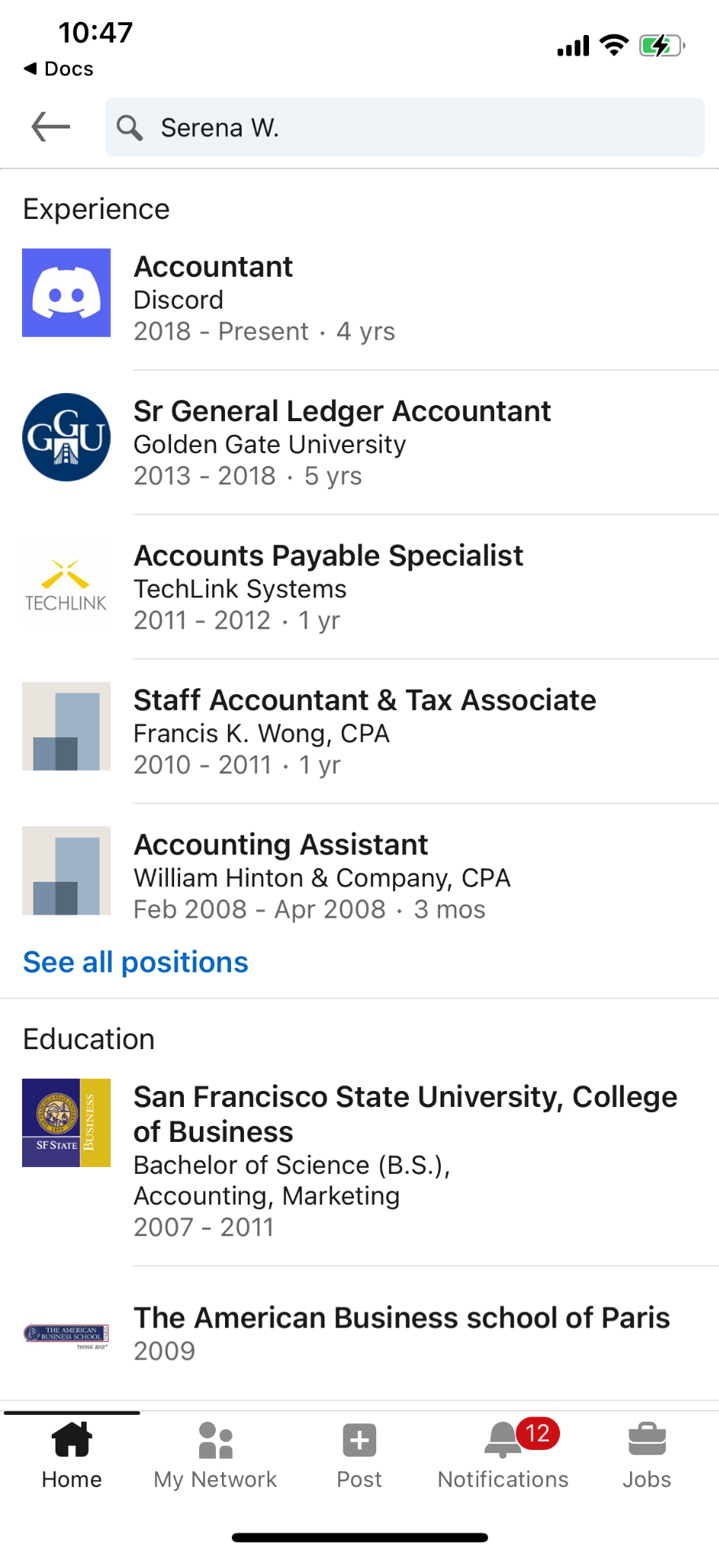
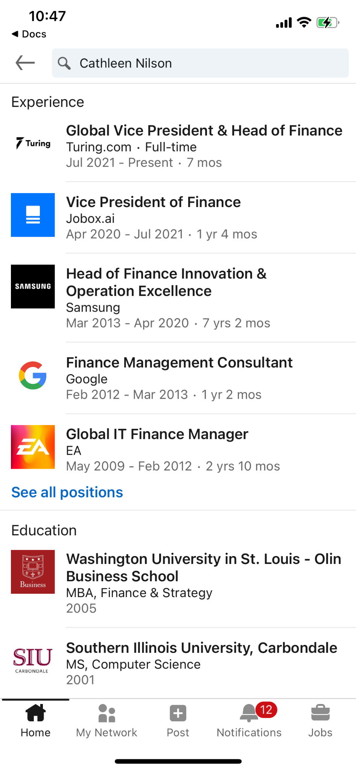
Prototype 1: Comparing Pathways
Jake
BYU Junior, Accounting
Which profile(s) were the most helpful? The most unhelpful? Why?
Which profile(s) surprised you? Why?
Do you feel less/the same/more overwhelmed about your post-graduate plans?
Do you feel less/the same/more confident about your post-graduate plans?
How did these profiles change your view of your post-graduate life?
Which person would you want to connect with?
Created portfolio of LinkedIn profiles with similar educational background to user and diverse career paths
Surveyed user

Slide 20
Prototype 1: Results
What worked
Confirmed our assumption that learning about different post-graduate pathways decreased feeling of being overwhelmed about post-graduate plans (participant said they were less overwhelmed after looking at profiles)
Surprises
Confidence level in post-graduate plans did not change, even though participant felt less overwhelmed
New Learnings
Knowing that your first job is not your entire career (through seeing examples) helps decrease feelings of being overwhelmed by finding the perfect first job
Feeling a strong connection with one profile /pathway was more valuable than seeing a variety of paths

Slide 21
How might we give college students a honest, approachable look into the daily lives of people who are in post-graduate paths they’re interested in?

Slide 22
Experience Prototype 2
Solution
Assumption
Spend a day with someone living in a city you’re interested in moving to to get a sense of what a typical day looks like
Knowing a local peer’s routine gives you more knowledge of what your life could look like in that place

Slide 23

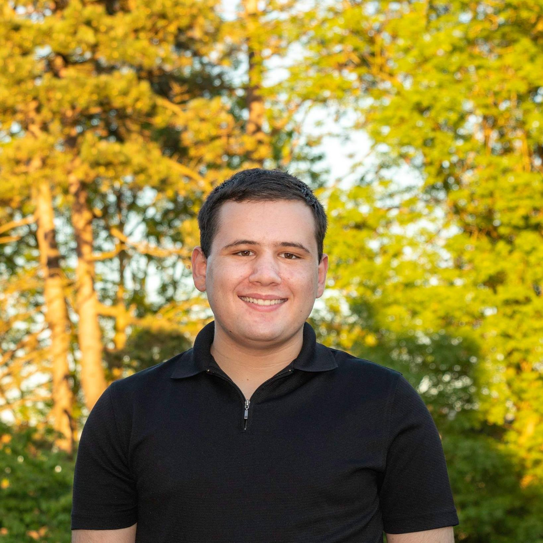

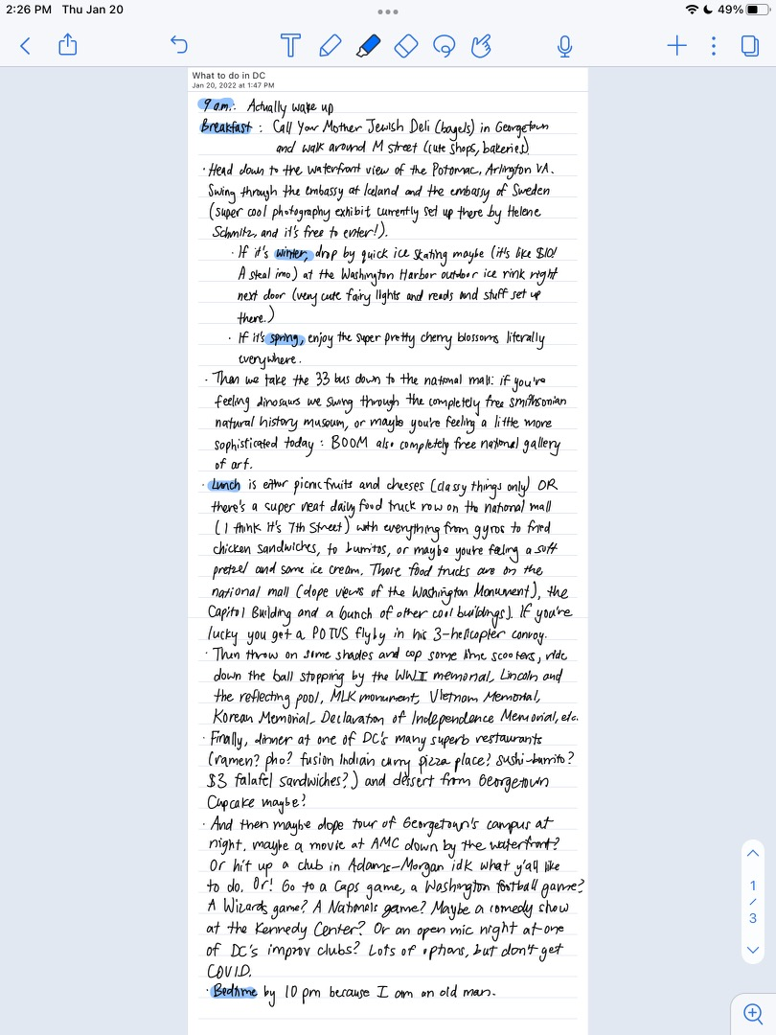
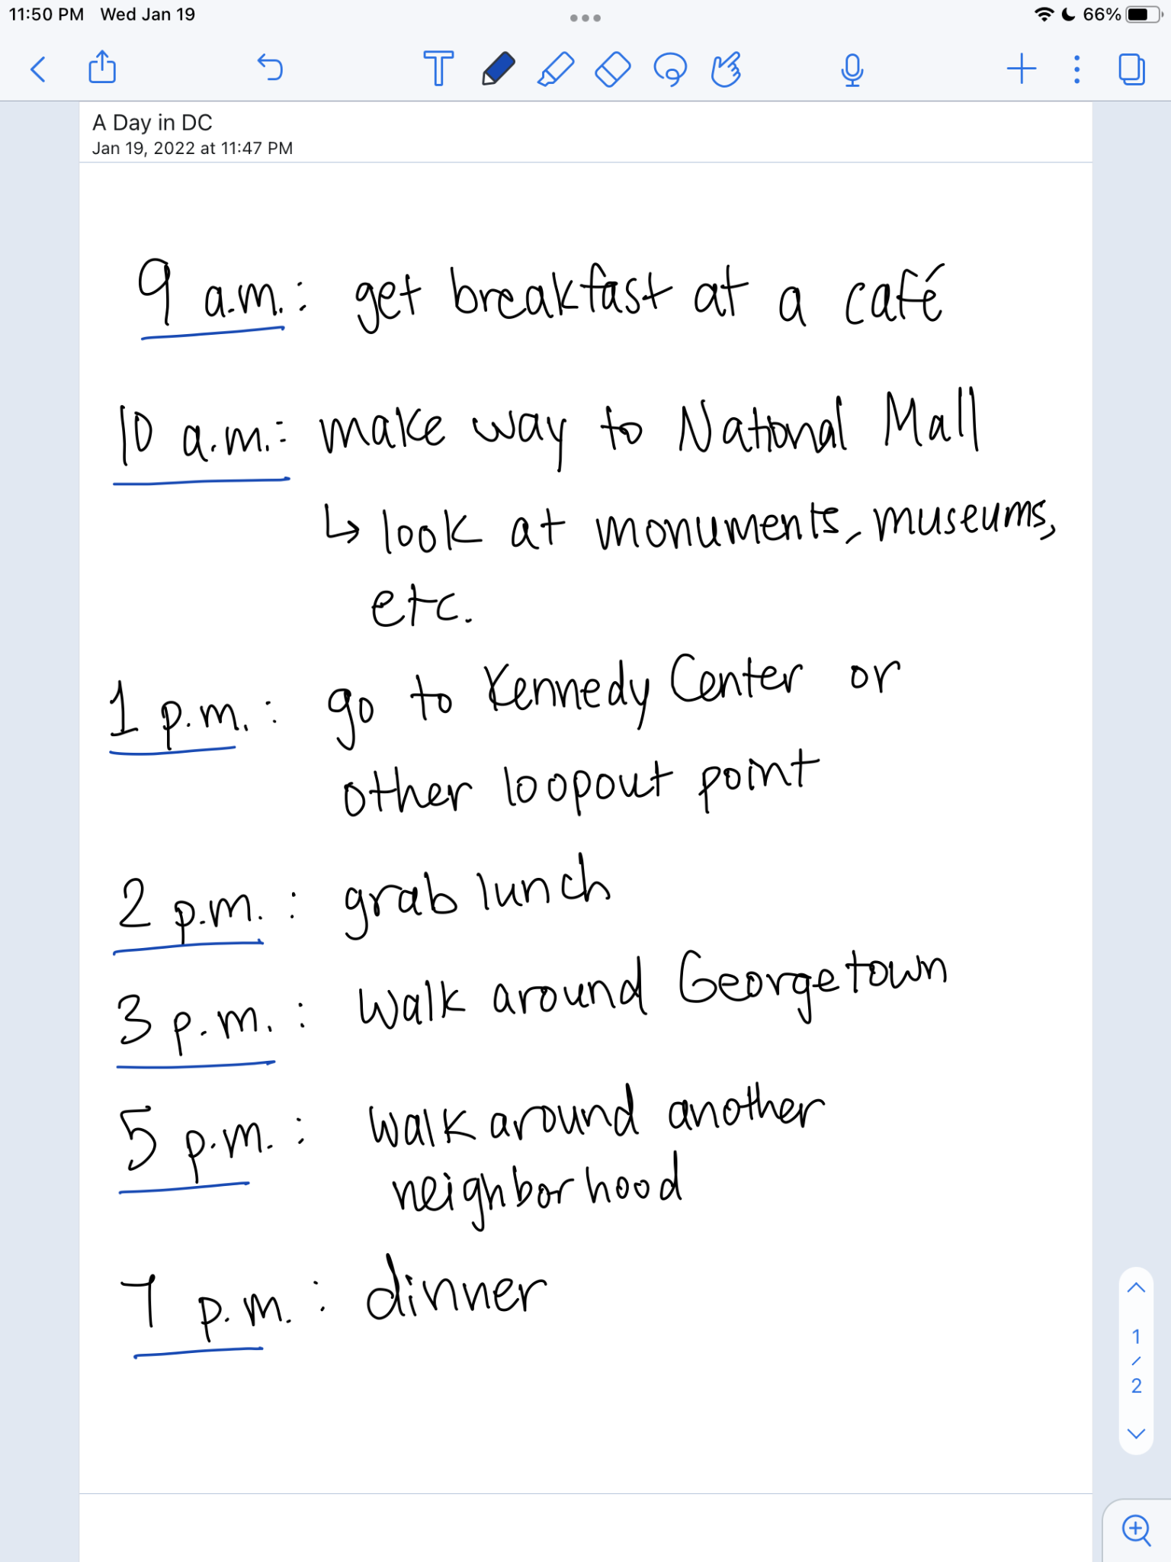
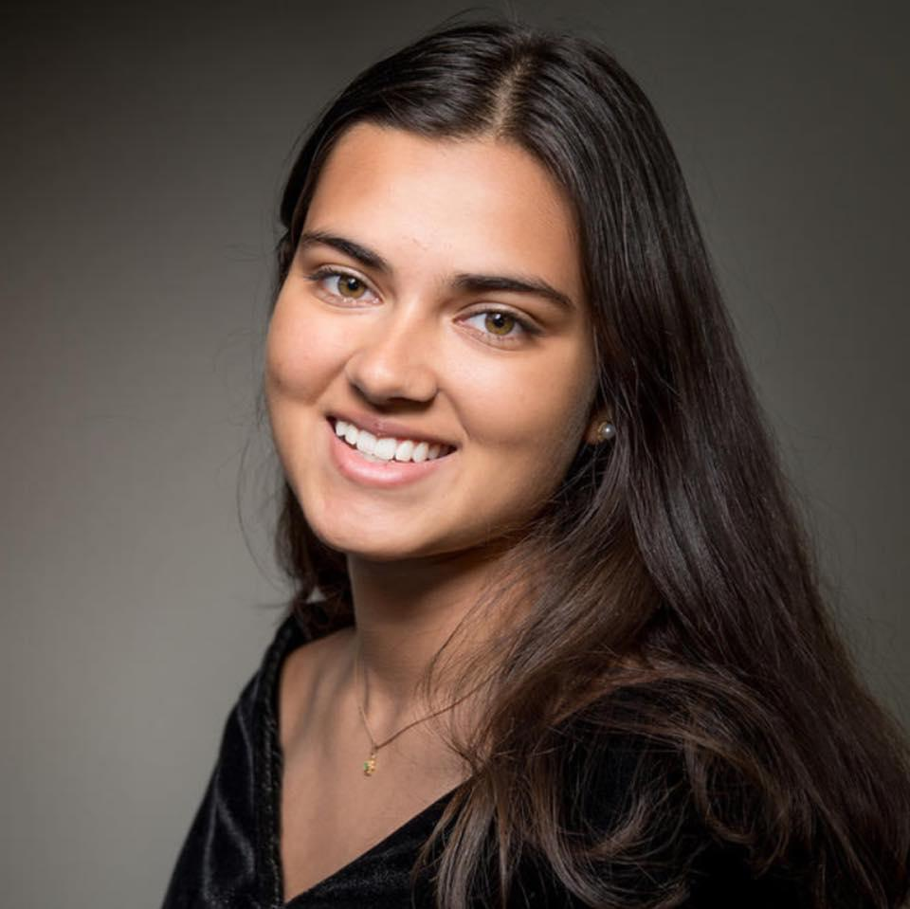
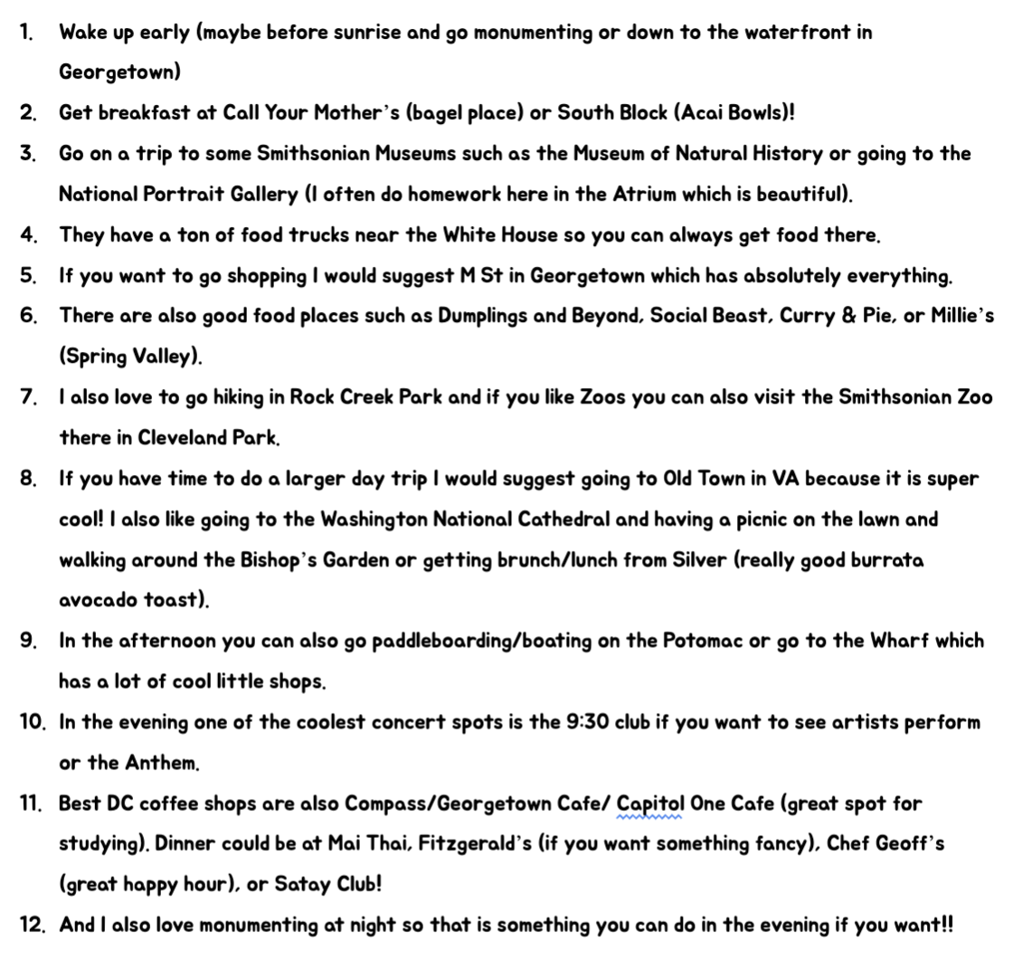
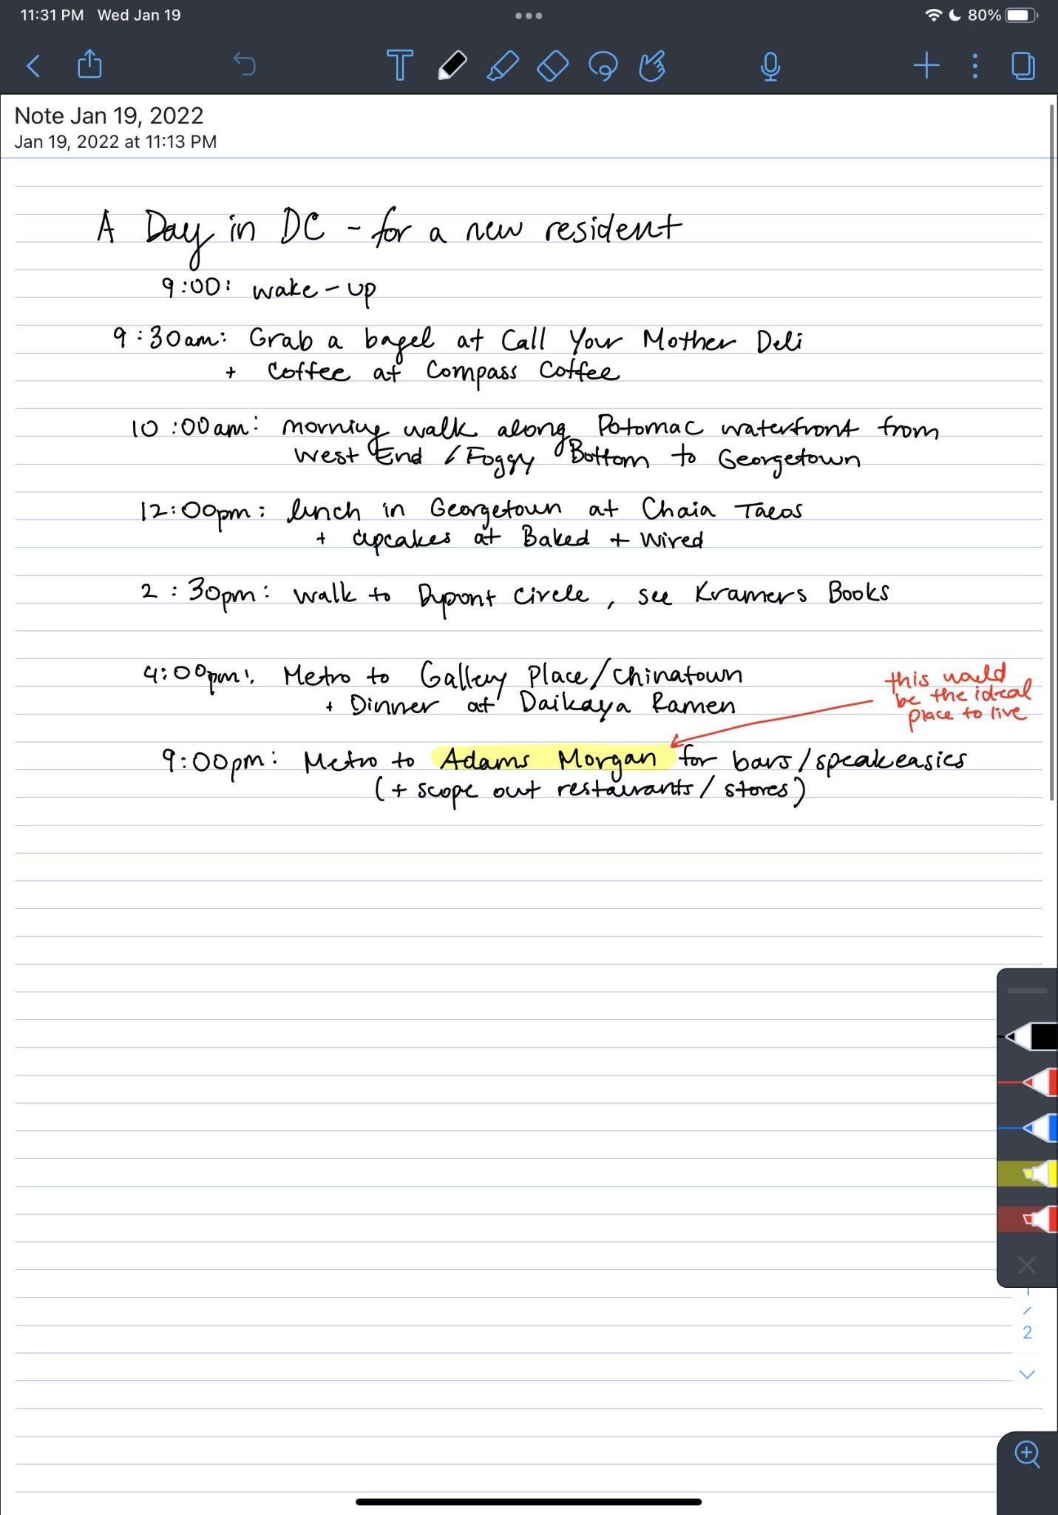
Prototype 2: Day in Your Future City
Connor
DC local
22 years old
Harris
DC local
22 years old
Kendall
DC local
21 years old
Jessica
Georgetown student
21 years old
Yasi
Stanford Senior
21 years old
Moving to DC after graduating
Obtained typical weekend day schedules from DC locals
Gave schedules to user

Slide 24
Prototype 2: Results
What worked
Confirmed our assumption that access to individuals’ schedules provides a “local lens” on a city
This prototype “contextualizes what’s possible in the city”
What didn’t work
Not personalized enough
Participant will have a demanding job, so while she was stoked about doing the routine, felt it wouldn’t be realistic for her lifestyle
Participant is vegetarian–are restaurant recommendations accessible?
Surprises
Less priority on the fun activity recommendations and more focus on how practical the routines would be for the day-to-day of her life
New Learnings
Identity and culture factors play into usefulness of itinerary
“I’d want to know what life would be like as an Indian-American in DC, like what restaurants have good Indian food”

Slide 25
How might we help Mihir turn casual friendships into lasting friendships?

Slide 26
Experience Prototype 3
Solution
Assumption
Create events that a group of people want to do that aligns with all of their schedules
People are more willing to hang out with acquaintances when they don’t have to plan

Slide 27
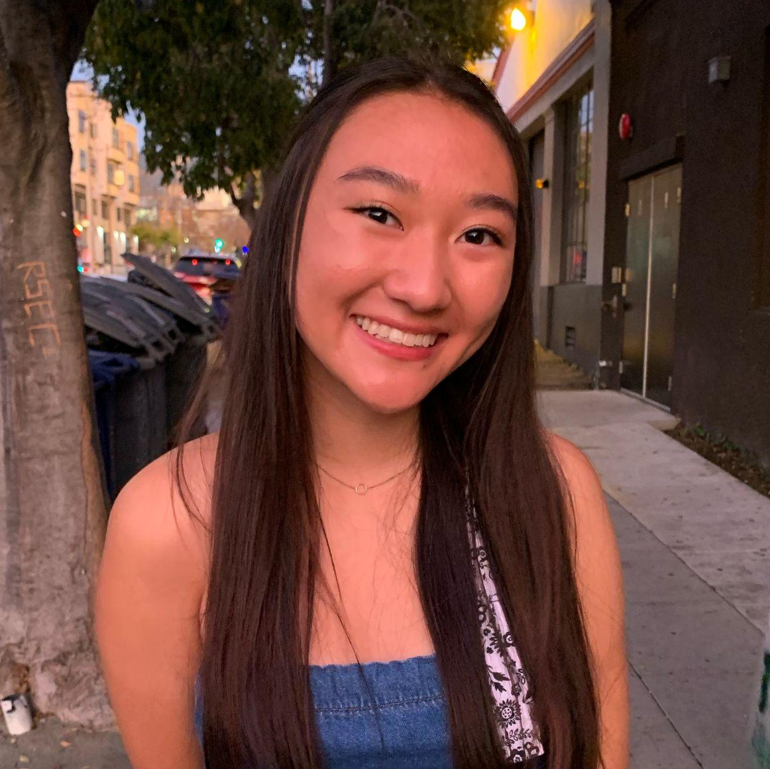
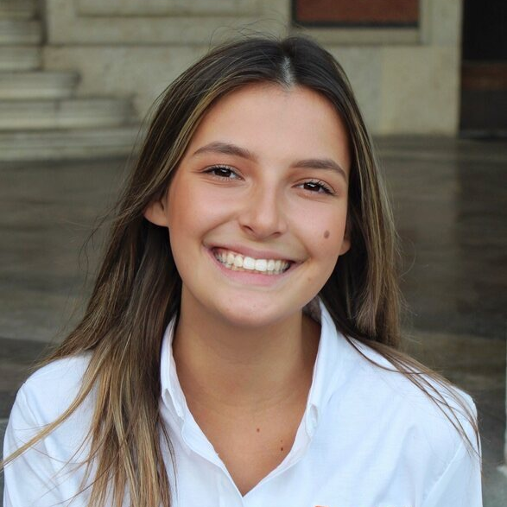
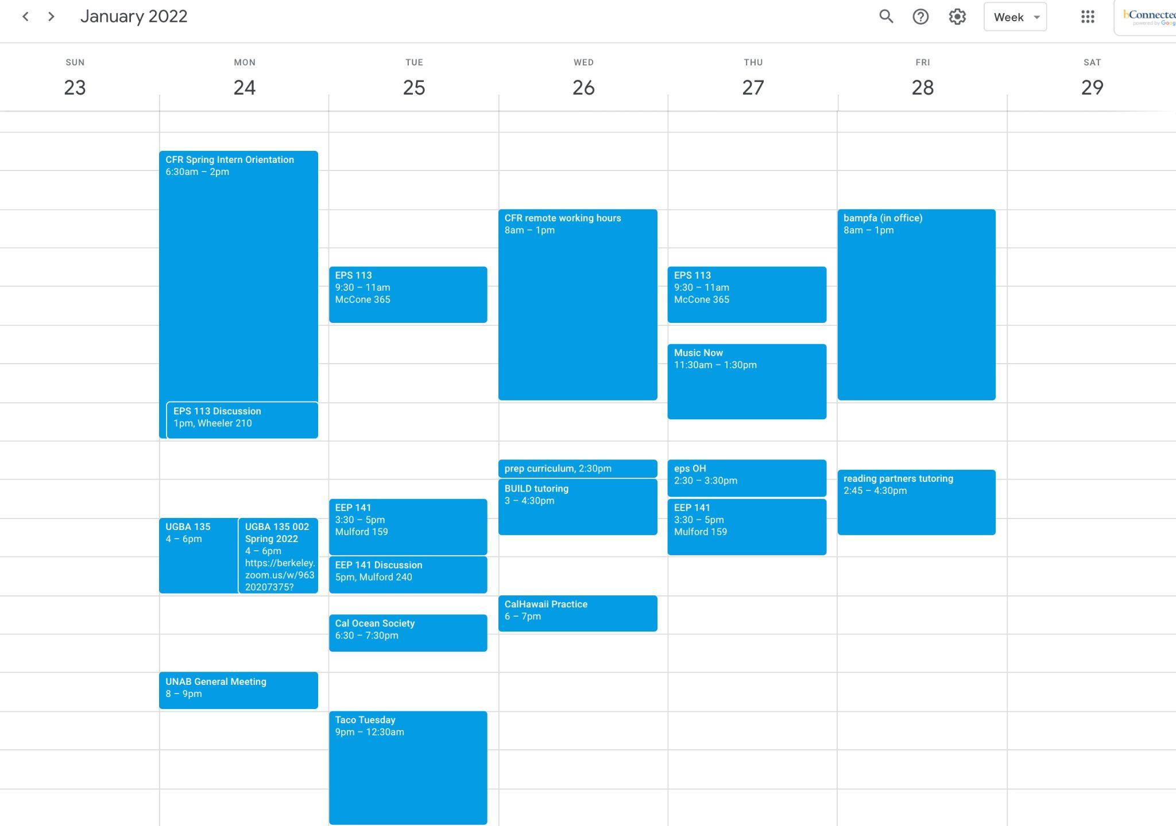
Prototype 3: Hassle-free Hangouts
Ellena
UC Berkeley Senior
Liza
UT Austin Senior
Great news! Sara, from your CalHawaii club, would love to join you for lunch at Wiki Wiki Hawaiian BBQ, a Hawaiian restaurant <15m walk from Berkeley’s campus, next Saturday, January 29th at noon. Are you down?
Related to relationship to person
Convenient
Aligns with calendar
Asked for 3 individuals user wants to get to know better, and user’s calendar
Created events for user and each individual they listed

Slide 28
Prototype 3: Results
What worked
Confirmed our assumption that people are more likely to hang out with individuals they don’t know as well if there is a plan created for them
Excitement around attending the majority of curated events
What didn’t work
Some participants wanted to get to know individuals that did not live close to them
Activities were not always personal enough in terms of cost, past experience
“Sounds fun, but I wouldn’t want to go spend money with someone I don’t know super well”
Surprises
Some participants were more excited about the longer, more established plans (e.g. long hikes) while others felt stressed by them
“Serious events stress me out to do one-on-one”
New Learnings
No one brought up being nervous about spending more 1:1 time with someone–the activity itself seemed to be the most important indicator of excitement around event

Slide 29
5
Summary

Slide 30
Key Learnings
From Prototype 1
Feeling connected to a particular path is more assuring than being exposed to many paths
From Prototype 2
Learning about things you could imagine doing on a normal weekend is more valuable than discovering novel activities in a new place
1
2
From Prototype 3
People are excited to participate in curated hangouts if logistical constraints are viewed as minimal
From Prototype 3
People are more excited to get to know someone one-on-one while doing an activity they already know they enjoy
3
4

Slide 31
Our key learnings are shaping our solution direction.
Create events that a group of people want to do that aligns with all of their schedules
Prototype 3
Deep one-on-one relationships are more valuable to new post-grads than a breadth of new connections
Learning from Prototypes 1, 2, 3
POV 1
Solution Base
Insight
POV 2
POV 3
Problem
Insight
= Solution Direction
People are overwhelmed by building intentional post-grad communities in a new place
Learning from Prototypes 2, 3
Focusing on activities people already enjoy rather than discovering new experiences
Automate the process of planning hangouts between new grads surrounding common activities in a new place, designed to foster meaningful long-term friendships
Potentially leaves out: people in rural areas, people who are uncomfortable meeting up with strangers, introverts

Slide 32
Our key learnings are shaping our solution direction.
Create events that a group of people want to do that aligns with all of their schedules
Prototype 3
Deep one-on-one relationships are more valuable to new post-grads than a breadth of new connections
Learning from Prototypes 1, 2, 3
POV 1
Solution Base
Insight
POV 2
POV 3
Problem
Insight
= Solution Direction
People are overwhelmed by building intentional post-grad communities in a new place
Learning from Prototypes 2, 3
Focusing on activities people already enjoy rather than discovering new experiences
Automate the process of planning hangouts between new grads surrounding common activities in a new place, designed to foster meaningful long-term friendships
Potentially leaves out: people in rural areas, people who are uncomfortable meeting up with strangers, introverts

Slide 33
Our key learnings are shaping our solution direction.
Create events that a group of people want to do that aligns with all of their schedules
Prototype 3
Deep one-on-one relationships are more valuable to new post-grads than a breadth of new connections
Learning from Prototypes 1, 2, 3
POV 1
Solution Base
Insight
POV 2
POV 3
Problem
Insight
= Solution Direction
People are overwhelmed by building intentional post-grad communities in a new place
Learning from Prototypes 2, 3
Focusing on activities people already enjoy rather than discovering new experiences
Automate the process of planning hangouts between new grads surrounding common activities in a new place, designed to foster meaningful long-term friendships
Potentially leaves out: people in rural areas, people who are uncomfortable meeting up with strangers, introverts

Slide 34
Our key learnings are shaping our solution direction.
Create events that a group of people want to do that aligns with all of their schedules
Prototype 3
Deep one-on-one relationships are more valuable to new post-grads than a breadth of new connections
Learning from Prototypes 1, 2, 3
POV 1
Solution Base
Insight
POV 2
POV 3
Problem
Insight
= Solution Direction
People are overwhelmed by building intentional post-grad communities in a new place
Learning from Prototypes 2, 3
Focusing on activities people already enjoy rather than discovering new experiences
Automate the process of planning hangouts between new grads surrounding common activities in a new place, designed to foster meaningful long-term friendships
Potentially leaves out: people in rural areas, people who are uncomfortable meeting up with strangers, introverts

Slide 35
Our key learnings are shaping our solution direction.
Create events that a group of people want to do that aligns with all of their schedules
Prototype 3
Deep one-on-one relationships are more valuable to new post-grads than a breadth of new connections
Learning from Prototypes 1, 2, 3
POV 1
Solution Base
Insight
POV 2
POV 3
Problem
Insight
= Solution Direction
People are overwhelmed by building intentional post-grad communities in a new place
Learning from Prototypes 2, 3
Focusing on activities people already enjoy rather than discovering new experiences
Automate the process of planning hangouts between new grads surrounding common activities in a new place, designed to foster meaningful long-term friendships
Potentially leaves out: people in rural areas, people who are uncomfortable meeting up with strangers, introverts

Slide 36
Next Steps
1
Flesh out our solution direction and scope
2
Market research
3
Concept video
4
Website

Slide 37
Questions?

Slide 38
6
Appendix

Slide 39
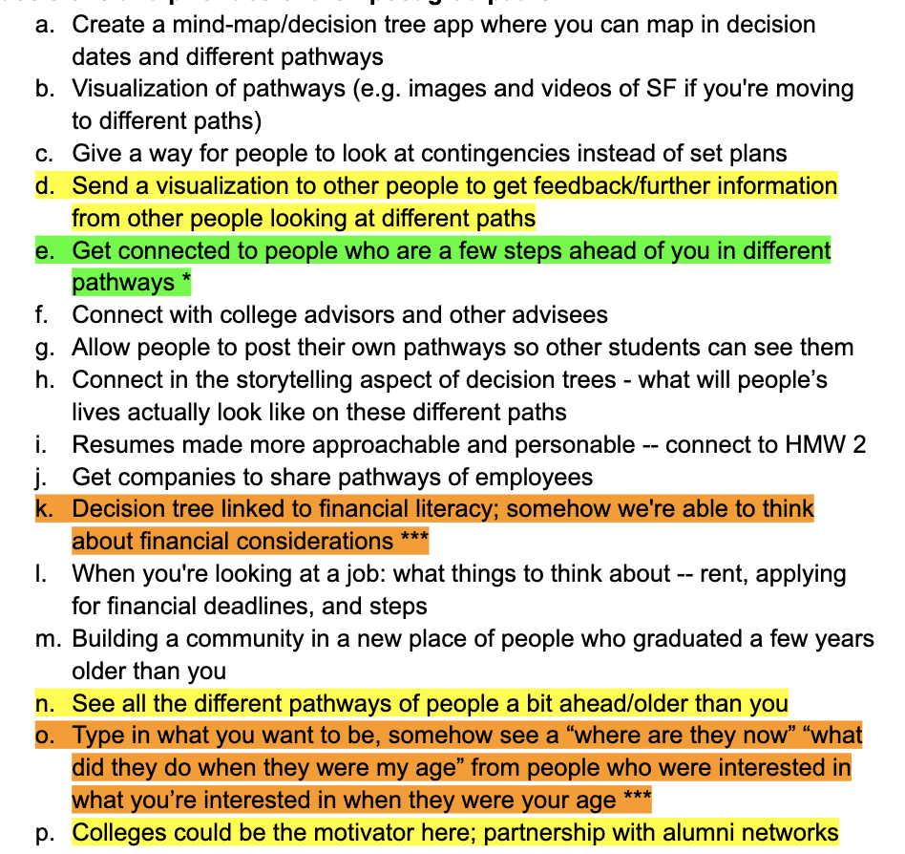
Solutions Brainstorm 1
How might we give college students the skills and tools to map out potential decisions and priorities of their post-graduate paths?
Notes:
Key: Individually like→Collectively love→Top

Slide 40
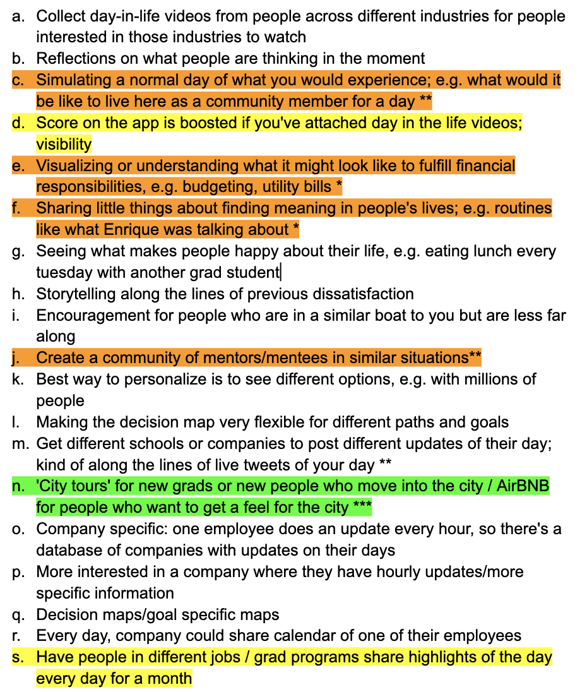
Solutions Brainstorm 2
How might we give college students a honest, approachable look into the daily lives of people who are in post-graduate paths they’re interested in?
Notes:
Key: Individually like→Collectively love→Top

Slide 41
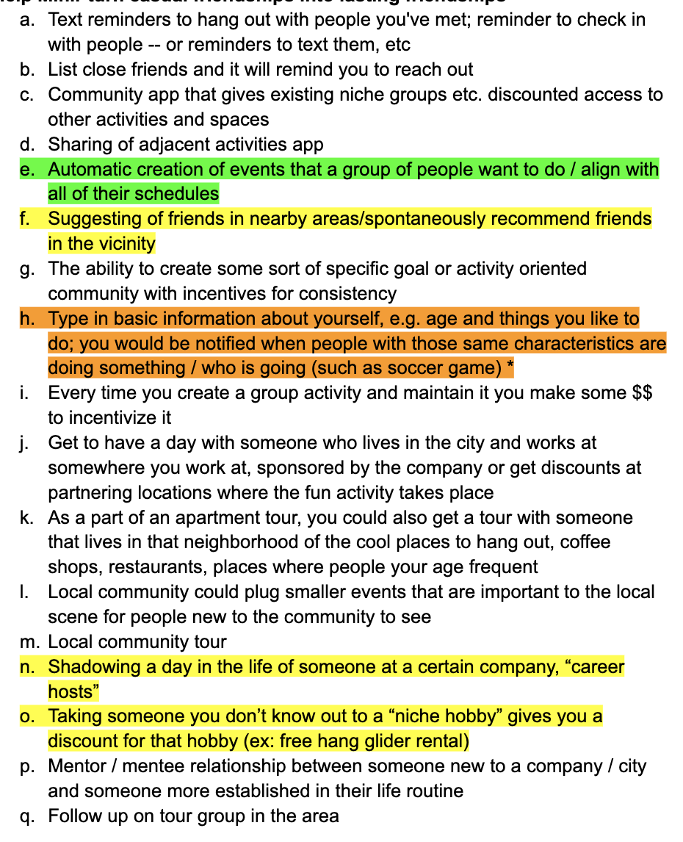
Solutions Brainstorm 3
How might we help Mihir turn casual friendships into lasting friendships?
Notes:
Key: Individually like→Collectively love→Top

Slide 42
Building Experience Prototypes
 | Prototype 1 | Prototype 2 | Prototype 3
Artifacts | Portfolio of LinkedIn profiles | Itinerary of things to do in DC | Personal calendar
Roles | Customer: Current college students | Customer: College student planning to move to DC after graduating Actors: DC locals | Customer: College students graduating soon Actors: Acquaintances (we pretended to know their schedule / willingness to participate in hangouts)
Scene / Environment | Digital; Google Doc created for sharing LinkedIn profiles | Digital, shared itineraries through text, DC area | Digital, Google Forms

Slide 43
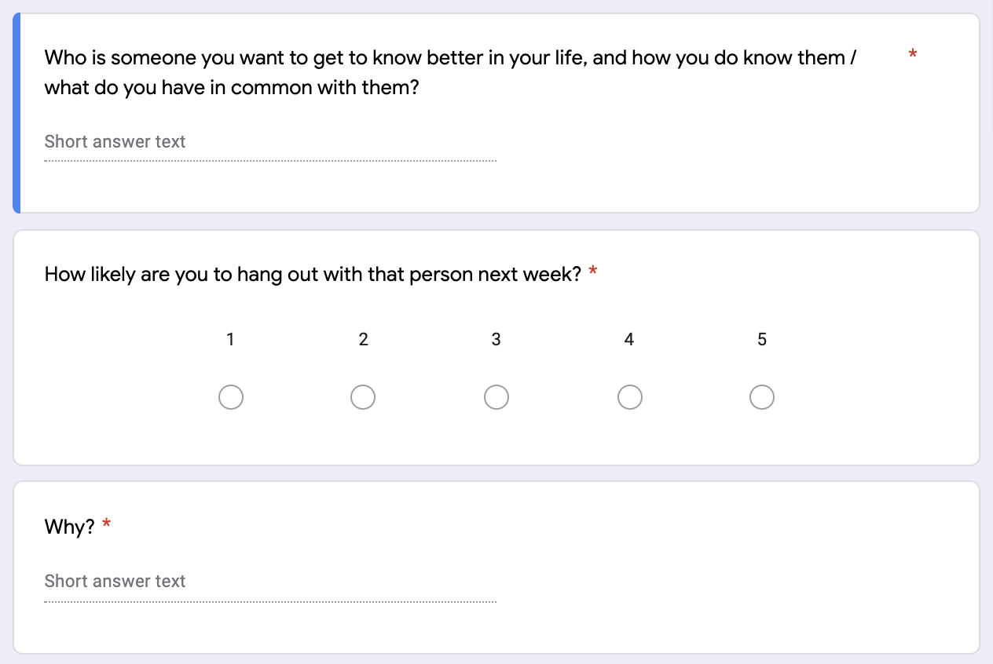
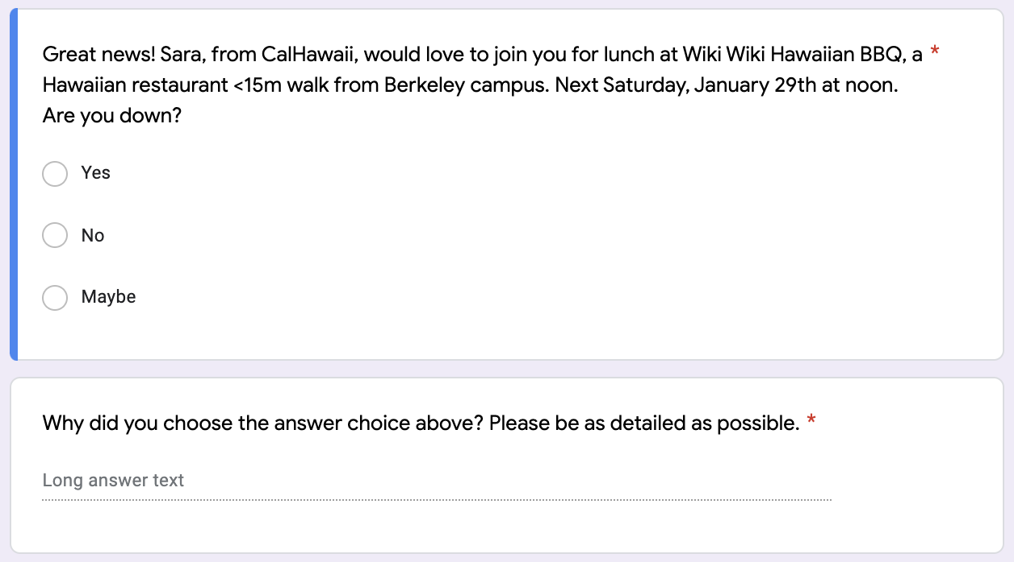
Prototype 3: Surveys 1 and 2
Survey 1. Questions below repeated 3x to learn about 3 individuals user would like to get to know and what they have in common with them
Survey 2. Activities curated for each of the three individuals user indicated on survey 1. Examples activity shown below

